Slide 1

Multiple Linear Regression

Slide 2

What is MLR?
Multiple linear regression is used to estimate the relationship between two or more independent variables and one dependent variable.

Slide 3
What MLR help you to do?
How strong the relationship is between two or more independent variables and one dependent variable (e.g. how rainfall, temperature, and amount of fertilizer added affect crop growth).
The value of the dependent variable at a certain value of the independent variables (e.g. the expected yield of a crop at certain levels of rainfall, temperature, and fertilizer addition).

Slide 4

Formula of MLR?

Slide 5
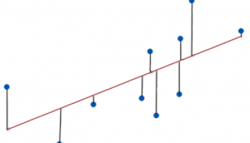
What is standard deviation in MLR?
The standard error of the regression, also known as the standard error of the estimate, represents the average distance that the observed values fall from the regression line.
Conveniently, it tells you how wrong the regression model is on average using the units of the response variable.
Smaller values are better because it indicates that the observations are closer to the fitted line.

